Slide 1
Experiment Summary and Analysis
Kara Bolli, Keshav Maheshwari, Edmund Ruan, Alexander Toro

Slide 2
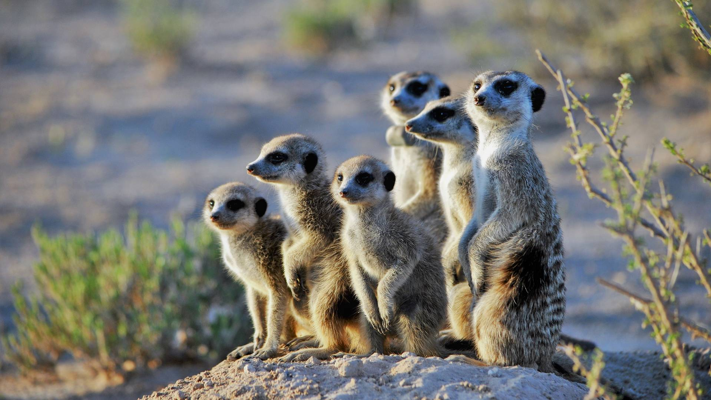
Introduction to Experiment
Humans are evolutionary social creatures. But with the rise in social media use and people getting comfortable with isolation, is this all coming to an end?
Are people turned away by large groups of people?
Are places as attractive when they are full of people?
Experiment:
Treatment: People present in photos
Control: No people present in photos
Notes:
Humans are social creatures. But with the rise in social media use and along with it more people comfortable with isolation, is this all coming to an end? Our team decided to conduct an experiment that would test the presence of people in a popular excursion site (treatment) on a person’s interest in going there. Curious about whether or not people are turned away by large groups of people or do not think a popular tourist destination is as attractive when it is full of people. Basically whether people are turned away from large crowds.

Slide 3
Hypothesis
Alternative Hypothesis: There will be a difference in one’s desire to visit a certain location whether they see the photograph with lots of people or virtually no people.
Null Hypothesis: There will be no difference in one’s desire to visit a certain location whether they see the photograph with lots of people or virtually no people.

Slide 4
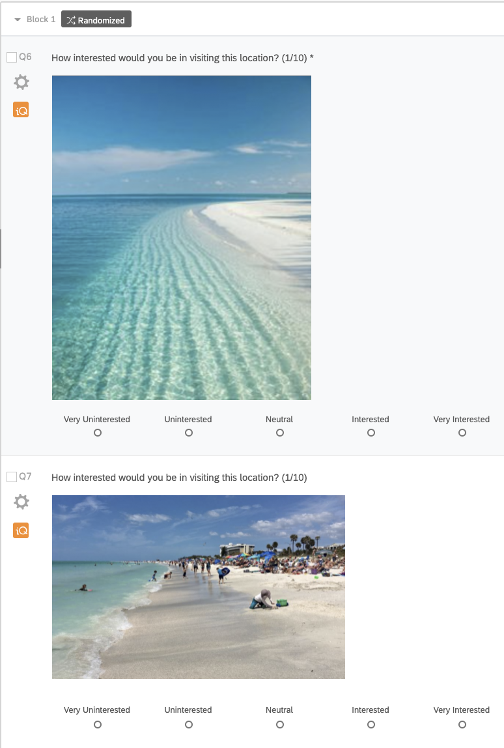
Experiment Design
Used 10 different locations
Beach, Disneyland, movie theater, restaurant, ice rink, pool, stadium, mountain, aquarium, orchard
10 photo blocks, each with a treatment and a control photo
20 photos total
Randomized within each photo block
Allowed each respondent to be part of both the treatment and control group
No limit on who could take survey

Slide 5
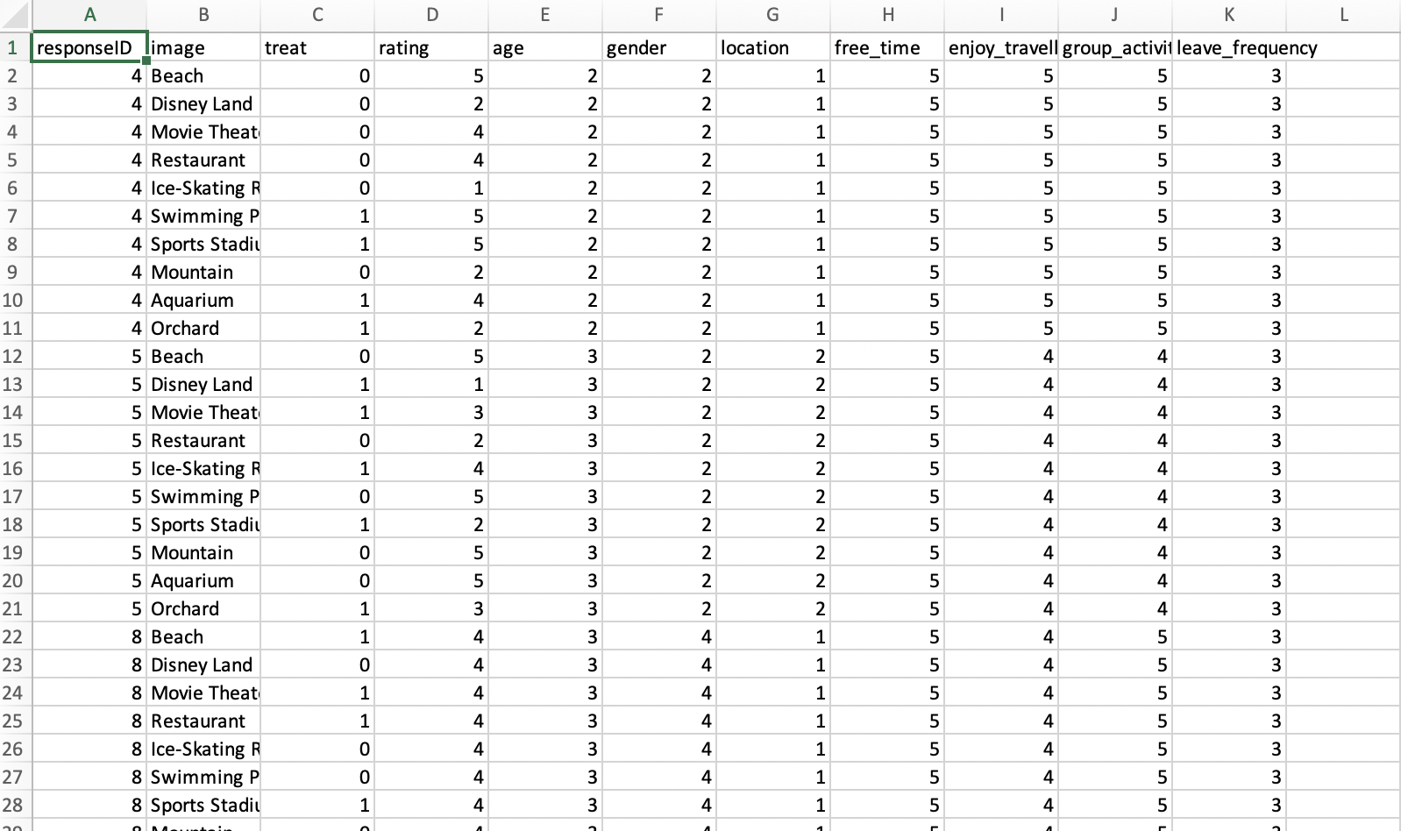
Data Sample

Slide 6
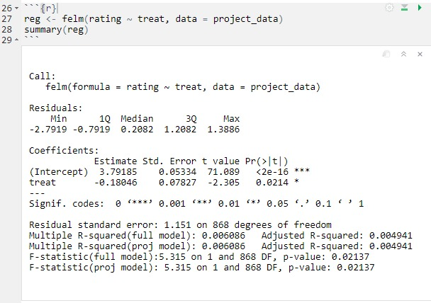
Regression Analysis
Regression of rating on treatment
Treatment Effect is -0.18
Negligent effect but statistically significant

Slide 7
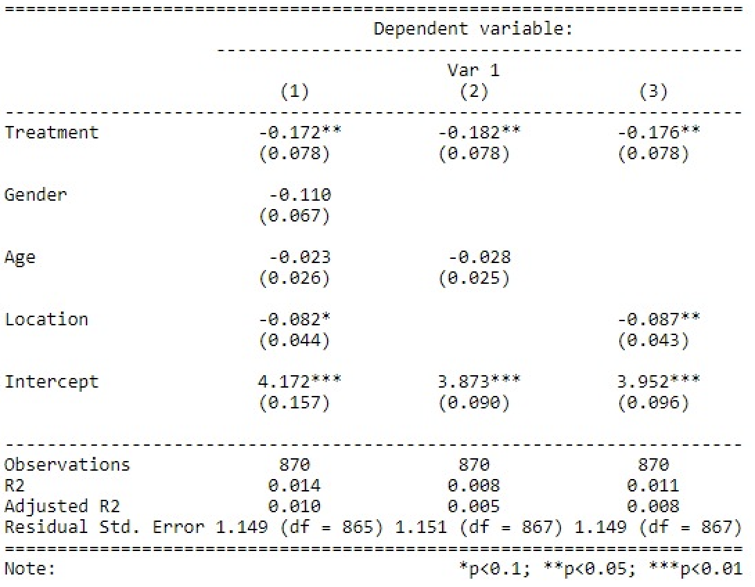
Regression Analysis cont...
Negative treatment coefficients statistically significant with a p-value of 0.05
Gender is not statistically significant in regression one
Age is not statistically significant in regressions one and two
Location has a statistically significant impact on the regression
Urban areas have the smallest impact
A mix of urban and rural had largest impact
Notes:
Gender:
1 = Female
2 = Male
3 = Other
4 = Prefer not to answer
Age:
1 = under 18
2 = 18-24
3 = 25-34
4 = 35-44
5 = 45-54
6 = 55-64
7 = 65+
Location:
1 = Urban
2 = Rural
3 = A mix of urban and rural

Slide 8
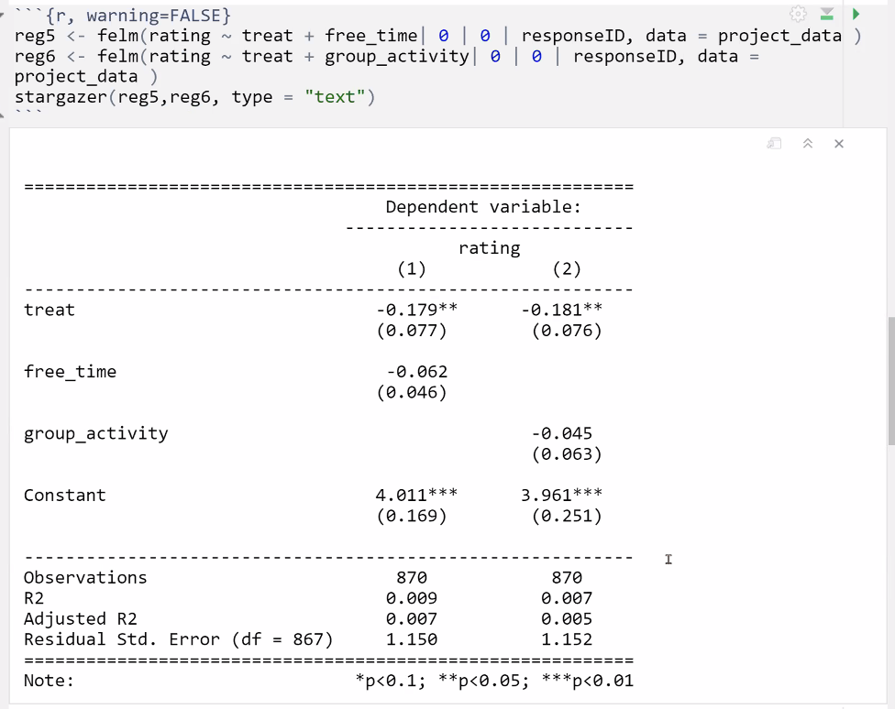
Regression Analysis cont...
Fixed effect regressions: controls for average difference among individuals (person characteristics)
Treatment on rating has a small but still statistically significant effect
Covariates free_time and group_activity are not statistically significant
Notes:
Free time:
1 = 0 hours
2 = 1-3 hours
3 = 4-7 hours
4 = 8-10 hours
5 = 11+ hours
Group activity:
1 = never with people
2 = rarely with people
3 = sometimes with people
4 = mostly with people
5 = always with people

Slide 9
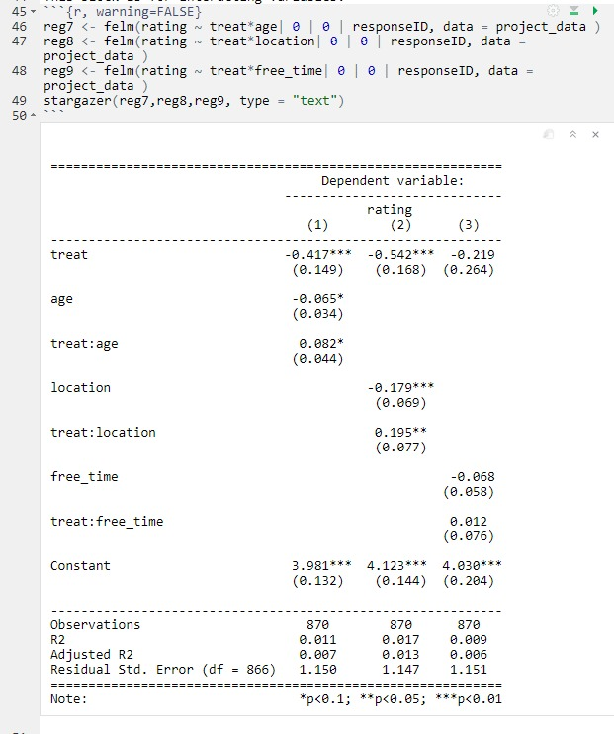
Regression Analysis cont...
Negative treatment effect when the regression of rating on treatment interacting with location with a p-value of 0.05
Since location is varied our results were averaged out to a minimal effect.
Notes:
Age:
1 = under 18
2 = 18-24
3 = 25-34
4 = 35-44
5 = 45-54
6 = 55-64
7 = 65+
Location:
1 = urban
2 = rural
3 = a mix of urban and rural
Free time:
1 = 0 hours
2 = 1-3 hours
3 = 4-7 hours
4 = 8-10 hours
5 = 11+ hours

Slide 10
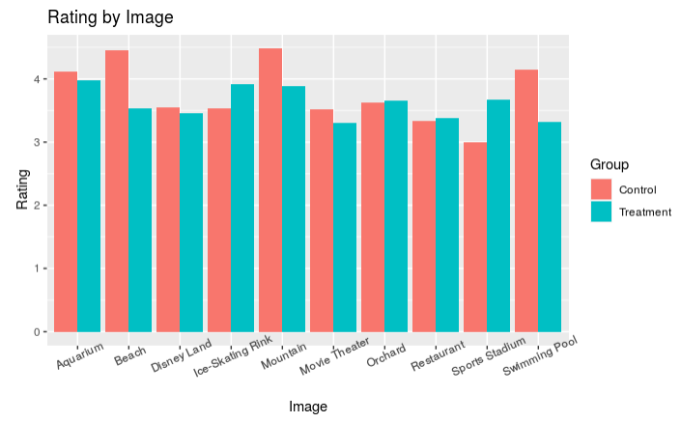
Limitations and Errors
Small sample size leads to a lack of variation
Since each image was susceptible to the treatment, there was an inherent bias that the respondents could have towards that particular location.
For example a crowded movie theatre (treatment) is considered a beneficial thing, while for someone else a deterrent.

Slide 11
Conclusion
There was no “failure to treat”
Every picture shown per person was counted as a response
This boosted the experiment’s power
But also made data compilation/processing more complex
Our experiment is relevant for visual marketing, especially during COVID
No concrete result, but slight preference towards images of empty places
Ideal experiment for next time:
More participants
Not during COVID
More diverse set of pictures

Slide 12
Thank you! Questions?

